Slide 1
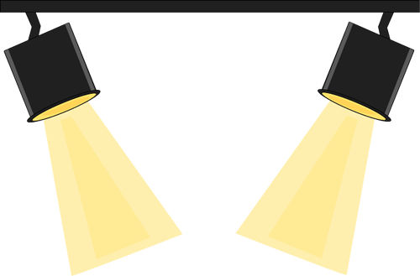
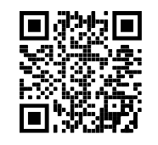
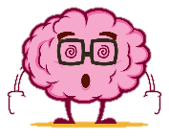
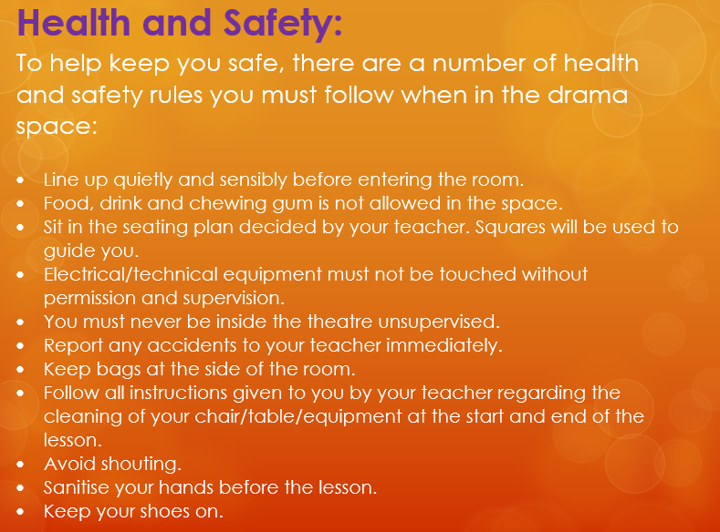
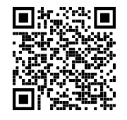
The next two schemes are:
DraGONS / ALIENS
WATCH LIST FOR THIS TERM (IF YOU CAN):
PACE
THE 4 P’S
PITCH
How to train your dragon 2010
PAUSE
Theatre Etiquette:
PROJECTION
What Is Theatre? Crash Course Theatre #1
What is promenade theatre?
Home 2015
(DreamWorks)
What performance skills can we use to show emotion?
Scan this to access KS3 BBC Bitsize Drama Portal
Please sketch a ‘Theatre in the round’ stage

Slide 2
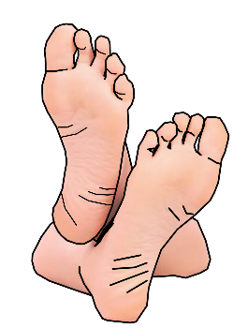
Just some of the skills you will learn this term!
DO NOT put your feet up on the chair in front of you
Turn OFF your phone
DO NOT talk/shout whilst watching a performance/show
New Skill/Technique Retrieval
Knowledge/ skill | Definition
Stimuli | The starting point, idea or inspiration for your devised drama. It is what you base your drama around.
Gesture | In acting gesture is defined as a sign that communicates a character's action, state of mind and relationship with other characters to an audience.
Still Image or Freeze frame | This is where the action freezes as if someone has taken a picture midway through a performance. Conveys meaning and highlights the current scene.
Body as Prop | A genre (type) of drama that tells a story using over exaggerated movement. and physicality. Body as Prop Using your body to create props and objects on stage.
Improvisation | A very spontaneous performance without specific or scripted preparation.
Hot seating | A character is questioned by the group about his or her background, behaviour and motivation.
Movement | Where we move to on and around the stage avoiding the blocking another actor.
Physical Theatre | Physical theatre is a well-known genre of theatrical performance that encompasses storytelling primarily through physical movement.
Role Play | Role play is the act of imitating the character and behaviour of someone who is different from yourself.
Monologue | A long speech by one actor in a play
Narration | A commentary delivered to accompany a performance.
Slow Motion | Performing in manner whereby the action appears much slower than in real life.
Teacher in role | The teacher plays a role. They may ask questions of the students, perhaps putting them into role as well.
Role on the wall | A role on the wall diagram is an outline of a person with emotions/context of the character you are exploring written on it.
Status | Refers to the power difference in the relationship between two characters. A character in a high status behaves dominantly towards a character in a lower status.
DO NOT leave any rubbish behind
DO NOT get out of your seat unless you have asked a member of staff
BUT DO ENJOY YOURSELVES!
Stage Types

