Slide 1





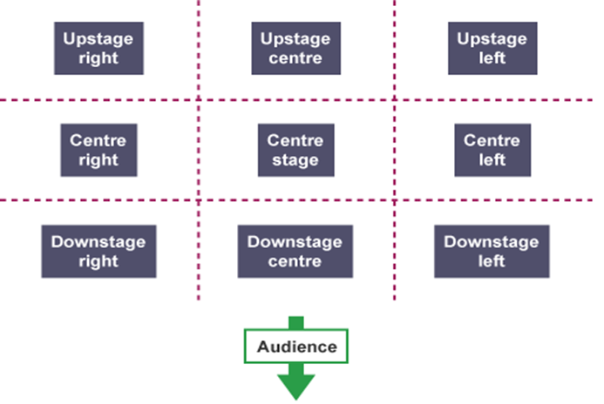
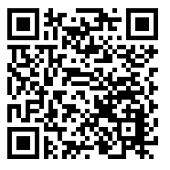

The next scheme of learning is:
Spooky
stories
Fun Extra Activities
PACE
THE 4 P’S
Write a short scary story
Design a poster for the Darkwood Manor competition
Design a costume for ‘Mrs Brown’ who you will meet in lesson!
PITCH
PAUSE
PROJECTION
Stage Positioning
New Skill/Technique Retrieval
Knowledge/ skill | Definition
Stimuli | The starting point, idea or inspiration for your devised drama. It is what you base your drama around.
Hot seating | A character is questioned by the group about his or her background, behaviour and motivation.
Still Image or Freeze frame | This is where the action freezes as if someone has taken a picture midway through a performance. Conveys meaning and highlights the current scene.
Body as Prop | A genre (type) of drama that tells a story using over exaggerated movement. and physicality. Body as Prop Using your body to create props and objects on stage.
Teacher in role | The teacher plays a role. They may ask questions of the students, perhaps putting them into role as well.
Transition | This is the process in which something changes from one state to another
Movement | Where we move to on and around the stage avoiding the blocking another actor.
Storywhoosh/ Action narration | An interactive storytelling technique which enables a story to be brought alive by the storyteller and participants.
Characterisation | Developing and portraying a personality through voice and movement.
Promenade theatre | In promenade theatre there is no formal stage, both the audience and the actors are placed in the same space.
Narration | A commentary delivered to accompany a performance.
Soundscape | A collection of sounds created either by the actors themselves or by other means like cd/computer.
BBC Bitesize ‘KS3 Drama’ Quiz:
RECALL:
What are the 3 main performance skills used for effective physical theatre?
What is a Genre? What Genre are we focussing on this term?
What two skills could you use to create a room in a haunted house?

Slide 2

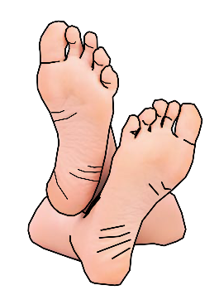


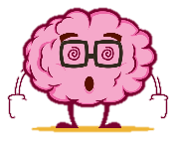
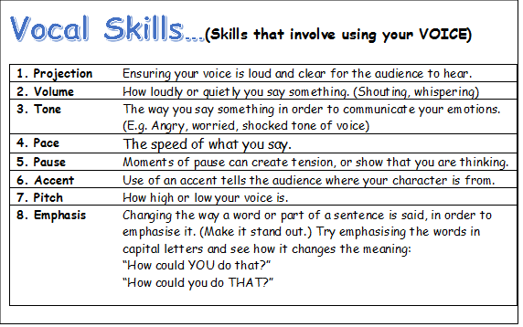


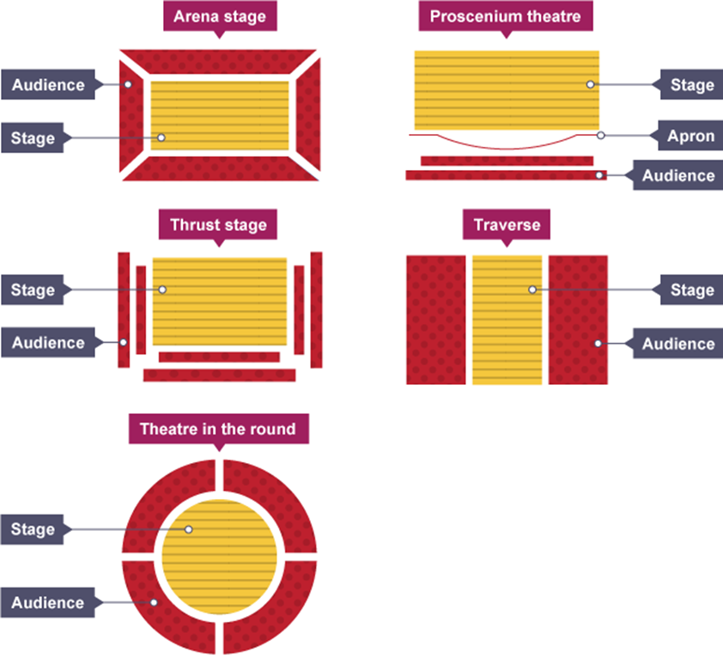
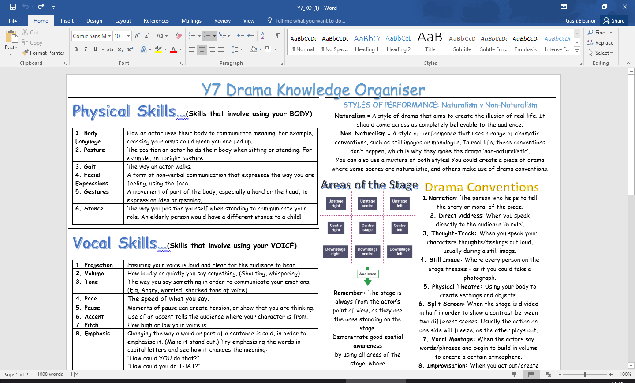
DO NOT talk/shout whilst watching a performance/show
DO NOT put your feet up on the chair in front of you
Turn OFF your phone
Key performance terminology for this term:
DO NOT leave any rubbish behind
DO NOT get out of your seat unless you have asked a member of staff
BUT DO ENJOY YOURSELVES!
Stage Types

