Slide 1




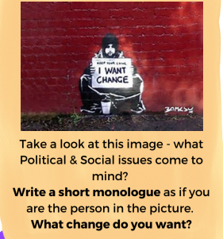
Tasks
Week 1 | Create a Theatre Etiquette poster
Week 2 | Create a Physical & Vocal Skills quiz and host with family!
Week 3 | Create a quiz on all the Knowledge/Skills you are acquiring this term and practice with the family
Week 4 | Research some facts about Homelessness
Week 5 | Sketch out the different stage types and match them with the right title
Week 6 | Listen to ‘Where is the Love – Black eyed pes *clean version*’ and write down all the phrases that come to mind.
Week 7 | See Below:
THE 4 P’S
The next scheme of learning is:
Overcoming obstacles
PACE
PITCH
PAUSE
PROJECTION
Stage Positioning
New Skill/Technique Retrieval
Knowledge/ skill | Definition
Stimuli | The starting point, idea or inspiration for your devised drama. It is what you base your drama around.
Sound design | The art and practice of creating sound tracks for a variety of needs in a performance.
Still Image or Freeze frame | This is where the action freezes as if someone has taken a picture midway through a performance. Conveys meaning and highlights the current scene.
Cross cutting | This term is used to describe two or more scenes which are performed on stage at the same time
Improvisation | A very spontaneous performance without specific or scripted preparation.
Placards | A printed or handwritten notice or sign used in a performance often to communicate a message to the audience.
Movement | Where we move to on and around the stage avoiding the blocking another actor.
Physical Theatre | Physical theatre is a well-known genre of theatrical performance that encompasses storytelling primarily through physical movement.
Role Play | Role play is the act of imitating the character and behaviour of someone who is different from yourself.
Debate | a formal discussion on a particular matter in a public meeting or legislative assembly, in which opposing arguments are put forward and which usually ends with a vote.
Narration | A commentary delivered to accompany a performance.
Flashback | A flashback is an interjected scene that takes the narrative back in time from the current point in the story.
Hot seating | A character is questioned by the group about his or her background, behaviour and motivation.
Characterisation | Developing and portraying a personality through voice and movement.
Multirole | Multi-roling is when an actor plays more than one character onstage

Slide 2
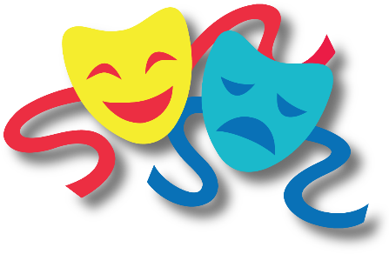
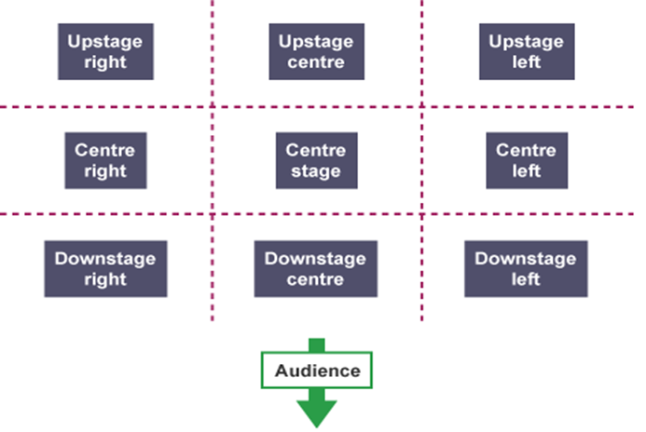
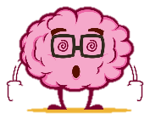
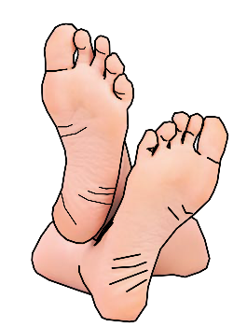



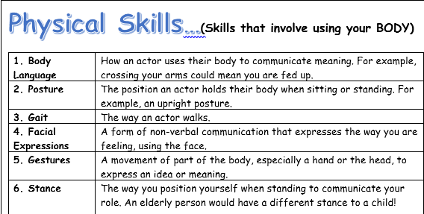


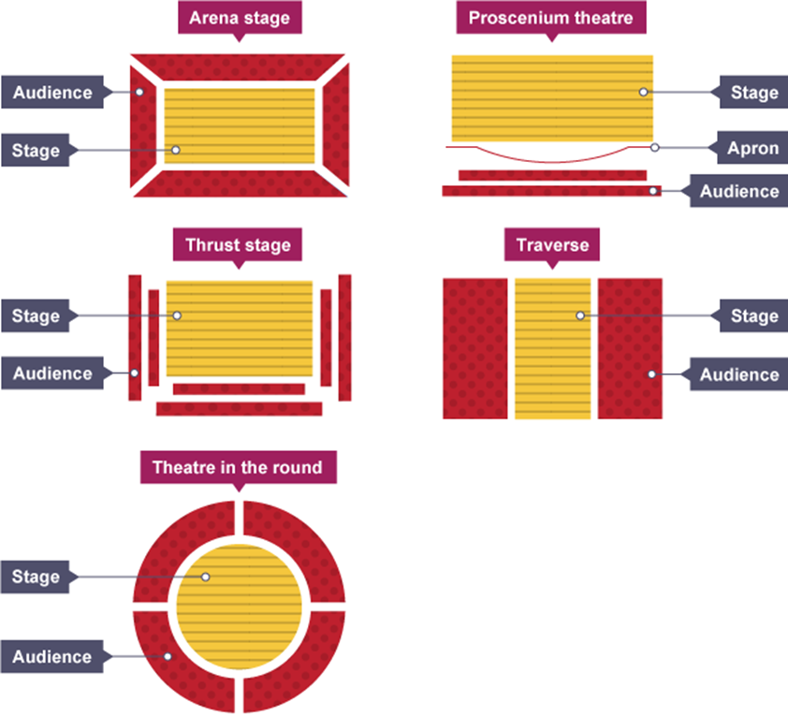
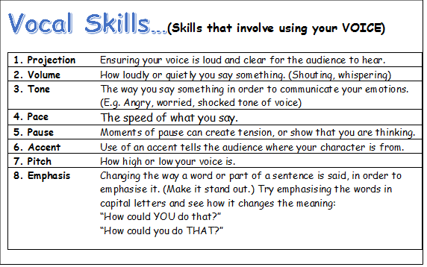
Key performance terminology for this term:
Stage positioning
DO NOT talk/shout whilst watching a performance/show
DO NOT put your feet up on the chair in front of you
Turn OFF your phone
DO NOT leave any rubbish behind
DO NOT get out of your seat unless you have asked a member of staff
BUT DO ENJOY YOURSELVES!
Stage Types

