Slide 1
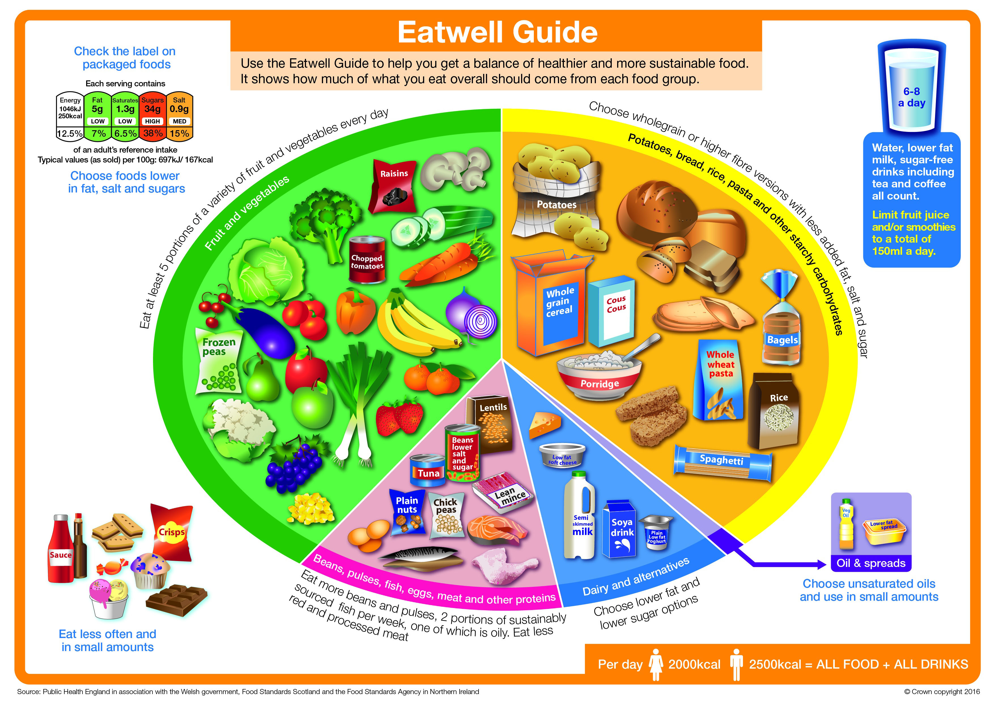

Slide 2
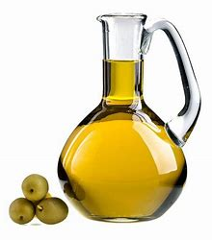
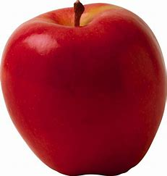
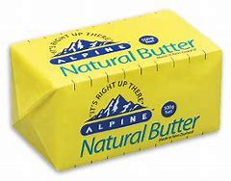
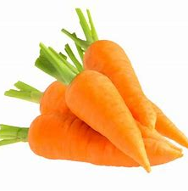
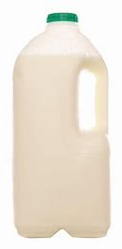
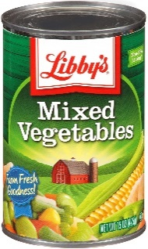
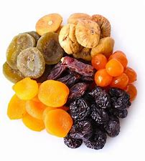
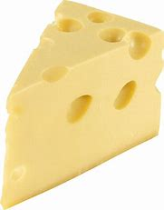
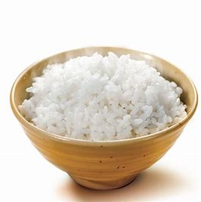
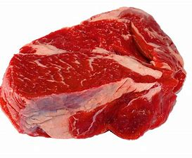
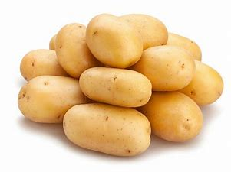
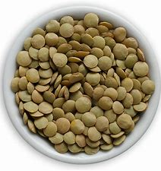
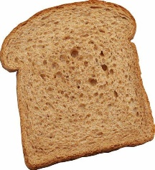
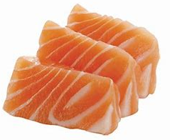
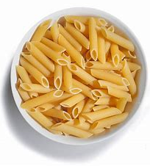
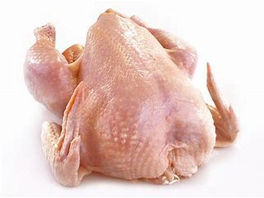
The Eatwell Guide – Year 7
Fats and Oils
Unsaturated fats are healthier fats and include vegetable, rapeseed, olive and sunflower oils.
Remember all types of fat are high in energy and should be eaten sparingly.
  Weekly Tasks
  Week 1 – In your book, list all the fruits and vegetables you eat in your diet – are you eating at least 5 a day?
  Week 2 – Makes a list of 10 meals that have starchy carbohydrates as a main ingredient.
  Week 3 – Try and find as many products as you can that contain dairy. Make a list in your book.
  Week 4 – Plan a high protein menu – include a starter, main and a dessert.
  Week 5 – Quiz a family member or friend on the Eatwell Guide. Note the questions and answers in your book..
  Week 6 – Create your own Eatwell Guide. Place the foods you eat as part of your diet into the correct sections.
  Week 7 – Evaluate your Eatwell Guide. How can you improve your diet to make it more balanced? Can you reduce snacks?
Fruits and Vegetables
Most of us still are not eating enough fruit and vegetables. They should make up over a third of the food we eat each day.
Aim to eat at least 5 portions of a variety of fruit and veg each day. Choose from fresh, frozen, tinned, dried or juiced.
Remember that fruit juice and smoothies should be limited to no more than a combined total of 150ml a day.
Fruit and vegetables are a good source of vitamins, minerals and fibre.
Dairy and Alternatives
Milk, cheese, yoghurt and fromage frais are good sources of protein and some vitamins, and they're also an important source of calcium, which helps keep our bones healthy.
Try to go for lower-fat and lower-sugar products where possible, like 1% fat milk, reduced-fat cheese or plain low-fat yoghurt.
Starchy Carbohydrates
Starchy food should make up just over a third of the food we eat. Choose higher fibre wholegrain varieties, such as wholewheat pasta and brown rice, or simply leave skins on potatoes.
There are also higher fibre versions of white bread and pasta.
Starchy foods are a good source of energy and the main source of a range of nutrients in our diet.
Proteins
These foods are good sources of protein, vitamins and minerals. Pulses, such as beans, peas and lentils, are good alternatives to meat because they're lower in fat and higher in fibre and protein, too.
Choose lean cuts of meat and mince, and eat less red and processed meat like bacon, ham and sausages.
Aim for at least 2 portions of fish every week, 1 of which should be oily, such as salmon or mackerel.
Find out about pulses, fish, eggs and meat.

Slide 3
Vitamins and Minerals – Year 8
Your body needs vitamins and minerals in small amounts, they help use other nutrients efficiently. You can usually get enough vitamins and minerals from a balanced diet that includes plenty of fruit and vegetables.
Vitamins
Weekly Tasks
Task 1: Create a set of revision cards for vitamins A, B, C.
Task 2: Create a set of revision cards for vitamins D, E, K.
Task 3: Create a set of revision cards for minerals.
Task 4: Choose a vitamin and research what happens if we don’t get enough.
Task 5: Choose a mineral and research what happens if we don’t get enough.
Task 6: Create a vitamins and minerals quiz – include 10 questions and answers.
Task 7: Design a plate of food that includes all vitamins and minerals.
Vitamin A
Food Source: Cheese, eggs, oily fish
Function: Fighting infection, better vision, keeping skin healthy
B Vitamins
Food Source: Meat, fish, milk, cheese, eggs, bread.
Function: Makes red blood cells, healthy skin and eyes, releases energy from food
Vitamin C
Food Source: Citrus Fruits (oranges, lemons)
Function: Healthy skin, eyes and nervous system, releasing energy from food
Vitamin D
Source: Our body creates this from direct sunlight but it is in oily fish, red meat and egg yolks
Function: Helps keep bones, teeth and muscles healthy
Vitamin E
Food Source: Vegetable oil, olive oil, nuts, seeds, cereals
Function: Healthy skin, eyes and immune system
Vitamin K
Food Source: Green vegetables, vegetable oil, cereals.
Function: Healing wounds
Minerals
Iron
Food Source: Red meat, beans, nuts.
Function: Making red blood cells.
Calcium
Food Source: Milk, green vegetables.
Function: Strong bones/teeth, healthy muscles, blood clotting
Zinc
Food Source: Red meat, beans, chickpeas.
Function: Helps to heal wounds.

Slide 4
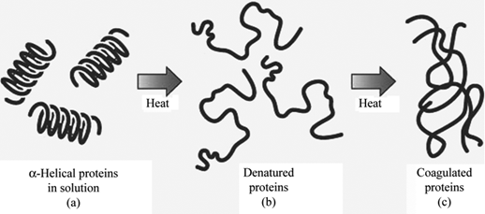
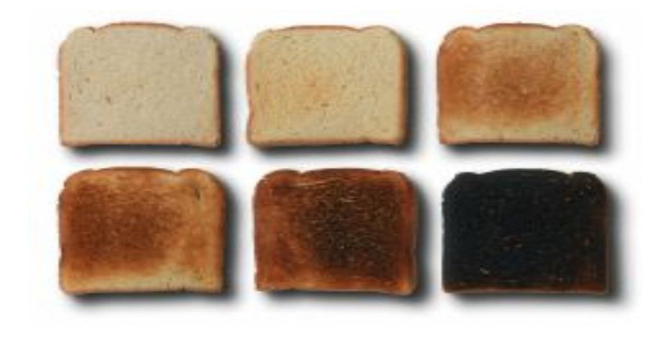
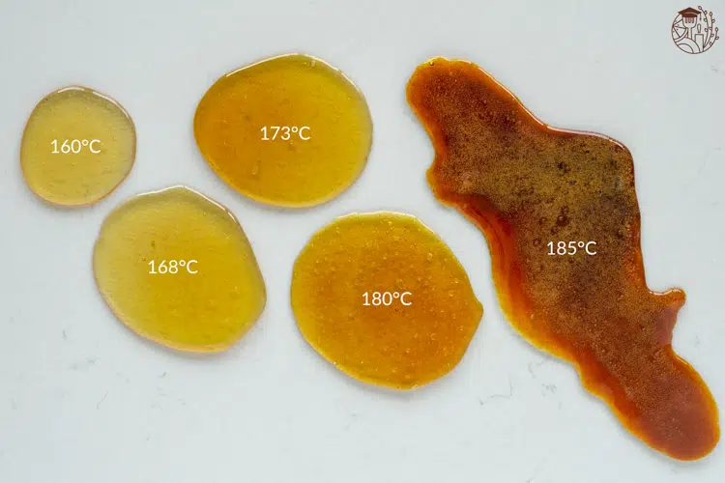
Proteins
Denaturation: The change in structure of protein molecules. The process results in the unfolding of the protein’s structure. Factors which contribute to denaturation are heat, salts, pH and mechanical action.
Coagulation: Coagulation follows denaturation. For example, when egg white is cooked it changes colour and becomes firmer (sets). The heat causes egg proteins to unfold from their coiled state and form a solid, stable network.
  Weekly Tasks
  Week 1 – Make revision cards for the functional properties of carbohydrates (dextrinisation and caramelisation)
  Week 2 – Make revision cards for the functional properties of proteins (denaturation and coagulation).
  Week 3 – Make revision cards for the functional properties of fats (aeration and plasticity).
  Week 4 – Research the plasticity of fats and how it effects the texture of baked foods.
  Week 5 – Link each functional property with at least 2 food products. E.g. dextrinisation – toast.
  Week 6 – Draw and label the denaturation and coagulation diagram in your book.
  Week 7 – Discuss how each functional property affects the final product when baking a sponge cake.
Functional Properties of Food – Year 9
Ingredients provide a variety of functions in recipes. Carbohydrate, protein and fat all have a range of properties that make them useful in a variety of food products.
These include:
Dextrinisation & Caramelisation of Carbohydrates
Denaturation & Coagulation of Proteins
Aeration and Plasticity of Fats
Carbohydrates
Dextrinisation: When foods containing starch are heated, they can also produce brown compounds due to dextrinisation. Dextrinisation occurs when the heat breaks the large starch polysaccharides into smaller molecules known as dextrins which produce a brown colour.
Caramelisation: When sucrose (table sugar) is heated above its melting point it undergoes physical and chemical changes to produce caramel. The colour goes from light to dark and the flavour becomes more bitter.
Fats
Aeration: Products such as creamed cakes need air incorporated into the mixture in order to give a well-risen texture. This is achieved by creaming a fat, such as butter or baking spread, with sugar. Small bubbles of air are incorporated and form a stable foam.
Plasticity: Fats do not melt at fixed temperatures, but over a range. This property is called plasticity.

