Slide 1
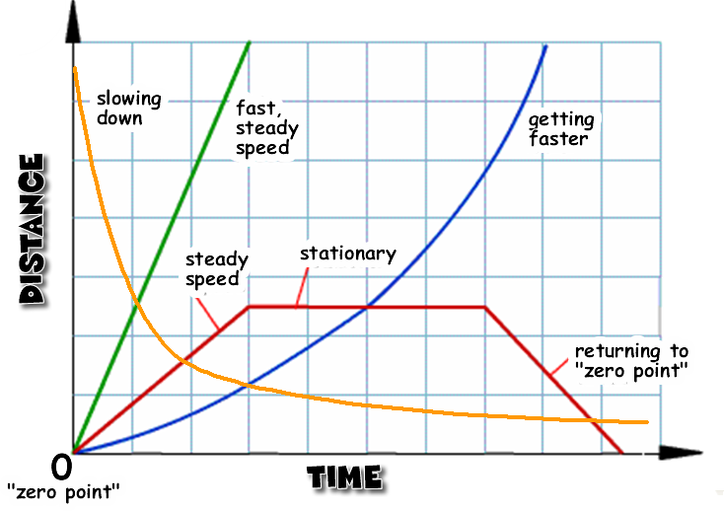
Year 8 Motion Knowledge Organiser
4. D/T graph keywords
Keyword | Meaning | Position on distance time graph
Accelerate | Speeding up | 1
Decelerate | Slowing down | 2
Constant speed | Staying the same speed | 3
Stationary | Not moving | 4
Speed | Distance covered in a certain time | The steepness of the line
1. Keywords
Speed | Distance ÷ time. Scalar quantity
Velocity | Distance (in a certain direction) ÷ time. Vector quantity
Distance | How far and object moves. Scalar quantity
2. Typical speeds
Walking | 1.5 m/s
Running | 3 m/s
Cycling | 6 m/s
Sound | 330 m/s
3. Calculating speed
Symbol | Name | Calculated by..
s | Distance (m) | = speed x time
v | Speed/Velocity (m/s) | = distance ÷ time
t | Time (s) | = distance ÷ speed
s = v t
2
1
3
3
4

Slide 2
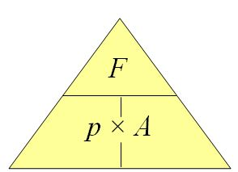
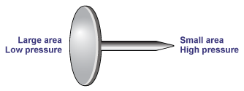
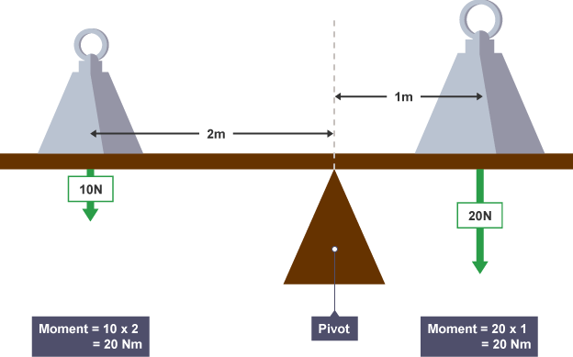
5. Calculating pressure
Symbol | Name | Calculated by..
F | Force (N) | = pressure x area
p | Pressure (Pa = N/m²) | = force ÷ area
A | Area (m²) | = force ÷ pressure
7. Moments:
Moments
1.To calculate a moment you need to know:
How much force is being applied (Newtons, N)
The distance from the pivot that the force is being applied (Meters, m)
2.The unit for moment is newton metre (Nm)
3.A small force over a large distance can generate the same moment as a large force over a small distance.
Moment = force x distance
6. Pressure in gases
Change | Effect | Reason
Increase Pressure | Increase volume | More particles so more collisions Increase the force stretching the balloon until the forces balance
Decrease pressure | Decrease volume | Less particles so less collision. Decrease the force causing the balloon to contract until the forces balance
Moment = 10 x 2
= 20Nm
Pivot
Moment = 20 x 1
= 20Nm

